Slide 1
Symbiosis

Slide 2
By the end of this lesson, you should be able to:
1. | Define symbiosis.
2. | Explain what mutualism is.
3. | Explain what parasitism is.
4. | Explain what commensalism is.

Slide 3
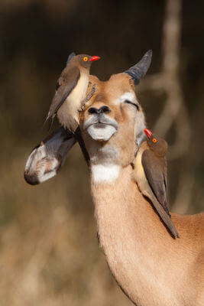
Symbiosis is an ecological relationship between two different species that live in direct contact with each other.
At least one of the species will always benefit from the relationship.

Slide 4
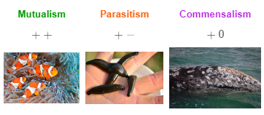
Symbiosis is categorised into three different groups.
These depend on whether the second species benefits, is harmed or is not affected by the symbiotic relationship.

Slide 5
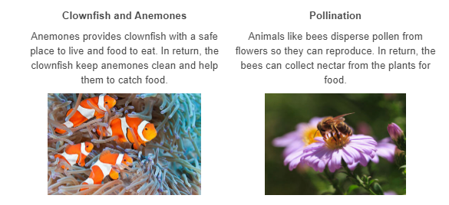
Mutualism is a symbiotic relationship where both organisms benefit by interacting with each other.
Below are two examples of mutualism:

Slide 6
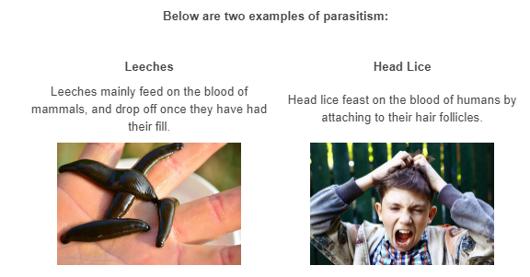
Parasitism is a symbiotic relationship where a parasite lives on or in the body of another organism (the host).
The parasite feeds off the host, taking nutrients without killing it.

Slide 7
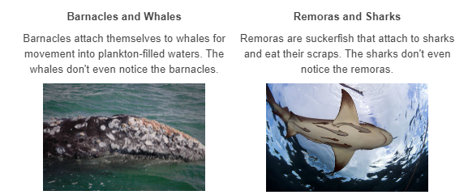
Commensalism is a symbiotic relationship where one organism benefits and the second organism is unaffected.
Below are two examples of commensalism:

Slide 8
